Slide 1
jQuery
(6 hours)
Notes:
Title - The learning outcome
Subtitle - Duration

Slide 2
In this section, we will discuss:
Introduction to jQuery
How to add jQuery to web pages
jQuery Syntax
jQuery Selectors
jQuery Attributes
jQuery- Dom Traversing
jQuery- CSS selectors methods
jQuery Effect
jQuery Animations
Notes:
Mention the parent topics one by one. This particular learning outcome has 4 parent topics.

Slide 3
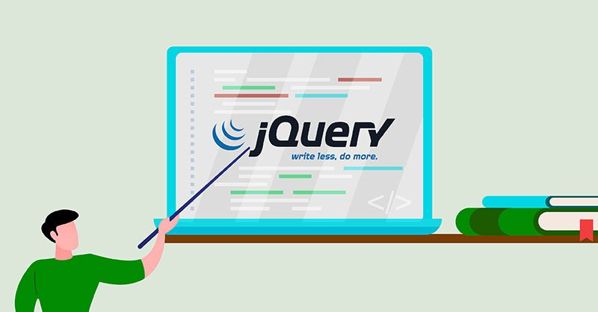
Introduction to jQuery
What is jQuery
jQuery is a lightweight, "write less, do more", JavaScript library. The purpose of jQuery is to make it much easier to use JavaScript on your website.
jQuery also simplifies a lot of the complicated things from JavaScript, like AJAX calls and DOM manipulation.
Image Source: https://www.cloudsigma.com/wp-content/uploads/An-Introduction-to-jQuery.jpg
Notes:
This slide talks about the case if we have to divide a subtopic further.
Title Box - Parent Topic
Subtitle box - Sub Topic
Body Text - Subtopic divisions (Subtopics of subtopics)

Slide 4
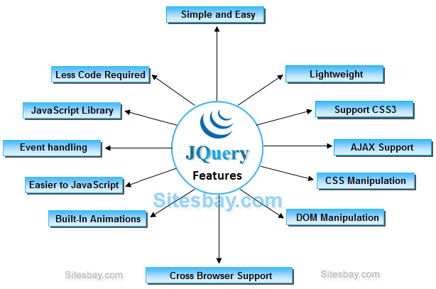
Introduction to jQuery
What is jQuery
The jQuery library contains the following features:
HTML/DOM manipulation
CSS manipulation
HTML event methods
Effects and animations
AJAX
Utilities
Image Source:
Notes:
Continuing from the last slide:
Title - Subtopic
Subtitle - Subtopic of Subtopic
Body - Description

Slide 5
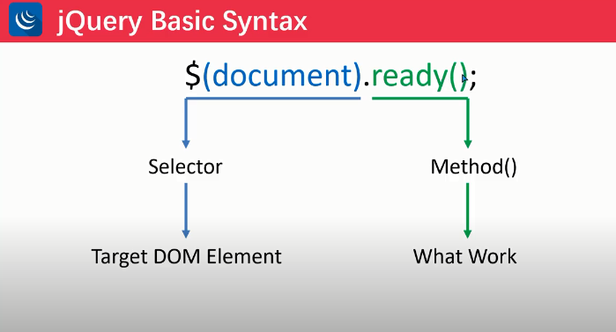
Introduction to jQuery
Why jQuery
A $ sign is to define/access jQuery
A (selector) is to “query (or find)” HTML elements in html page
A jQuery action() is the action to be performed on the selected element(s)
Image Source:https://www.devopsschool.com/blog/wp-content/uploads/2020/08/logic-syntax.png
Notes:
Continuing from the last slide:
Title - Subtopic
Subtitle - Subtopic of Subtopic
Body - Description

Slide 6
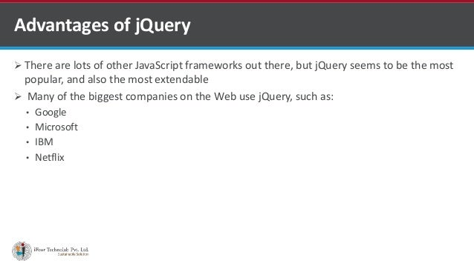
Introduction to jQuery
Advantages of jQuery
Wide range of plug-ins. jQuery allows developers to create plug-ins on top of the JavaScript library.
Large development community
It has a good and comprehensive documentation
It is a lot more easy to use compared to standard javascript and other javascript libraries.
Image Source: https://image.slidesharecdn.com/jqueryforwebdevelopment-170112092612/95/jquery-for-web-development-4-638.jpg?cb=1484213953
Notes:
Continuing from the last slide:
Title - Subtopic
Subtitle - Subtopic of Subtopic
Body - Description

Slide 7
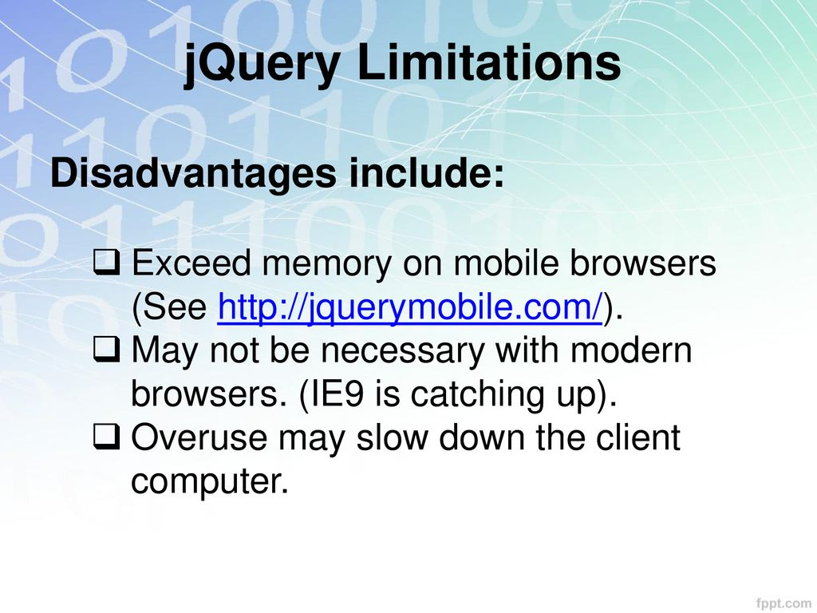
Introduction to jQuery
Disadvantages of jQuery
While JQuery has an impressive library in terms of quantity, depending on how much customization you require on your website, the functionality may be limited thus using raw javascript may be inevitable in some cases.
The JQuery javascript file is required to run JQuery commands, while the size of this file is relatively small (25-100KB depending on the server.
Image Source: https://slideplayer.com/slide/13798726/85/images/8/jQuery+Limitations+Disadvantages+include%3A.jpg
Notes:
Continuing from the last slide:
Title - Subtopic
Subtitle - Subtopic of Subtopic
Body - Description

Slide 8
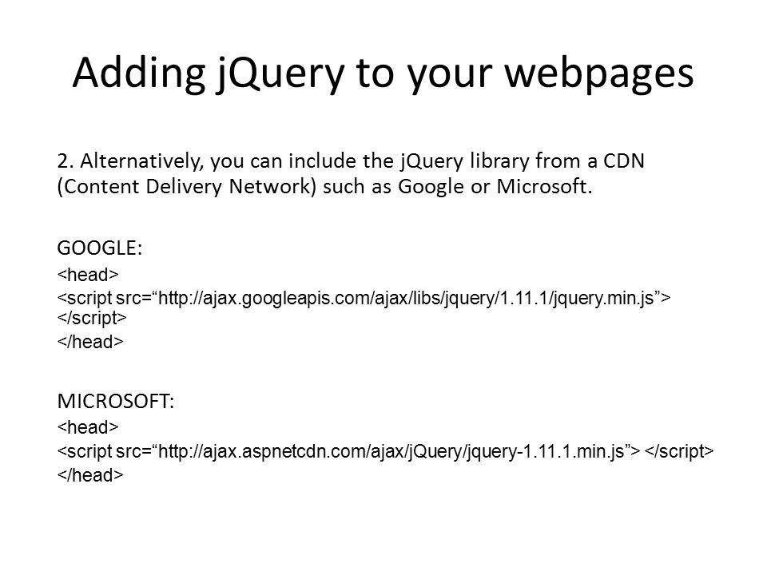
Introduction to jQuery
How to add jQuery to web pages
There are several ways to start using jQuery on your web site. You can:
Download the jQuery library from jQuery.com
Include jQuery from a CDN, like Google
Image Source:https://images.slideplayer.com/32/9842034/slides/slide_5.jpg
Notes:
Continuing from the last slide:
Title - Subtopic
Subtitle - Subtopic of Subtopic
Body - Description

Slide 9

Introduction to jQuery
jQuery Selectors
jQuery selectors allow you to select and manipulate HTML element(s).
All selectors in jQuery start with the dollar sign and parentheses: $().
Image Source:https://www.journaldev.com/wp-content/uploads/2014/09/jQuery-selector.png
Notes:
Continuing from the last slide:
Title - Subtopic
Subtitle - Subtopic of Subtopic
Body - Description

Slide 10
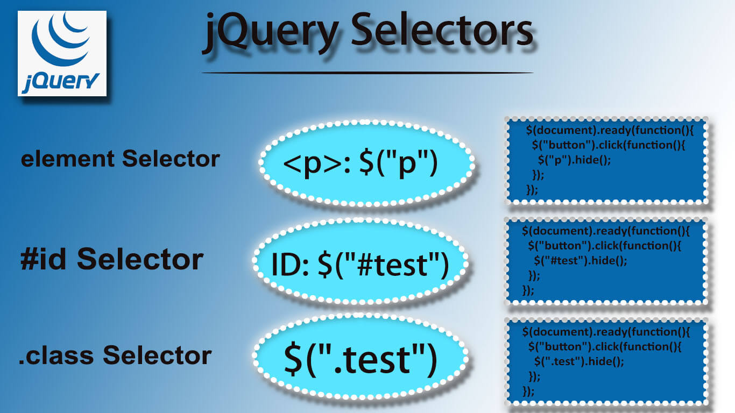
jQuery Selectors
Element Selector
The jQuery element selector selects elements based on the element name.
Selects all elements with the given tag name.
Image Source:https://www.myprograming.com/wp-content/uploads/2021/07/jqueryselector.jpg
Notes:
Continuing from the last slide:
Title - Subtopic
Subtitle - Subtopic of Subtopic
Body - Description

Slide 11
jQuery Selectors
#id Selector
The jQuery #id selector uses the id attribute of an HTML tag to find the specific element.
An id should be unique within a page, so you should use the #id selector when you want to find a single, unique element.
Image Source:https://www.myprograming.com/wp-content/uploads/2021/07/jqueryselector.jpg
Notes:
Continuing from the last slide:
Title - Subtopic
Subtitle - Subtopic of Subtopic
Body - Description

Slide 12
jQuery Selectors
.class Selector
The jQuery .class selector finds elements with a specific class.
To find elements with a specific class, write a period character, followed by the name of the class:
Image Source:https://www.myprograming.com/wp-content/uploads/2021/07/jqueryselector.jpg
Notes:
Continuing from the last slide:
Title - Subtopic
Subtitle - Subtopic of Subtopic
Body - Description

Slide 13
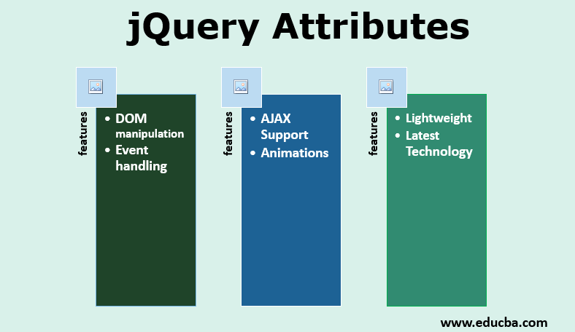
Introduction to jQuery
jQuery Attributes
Some of the most basic components we can manipulate when it comes to DOM elements are the properties and attributes assigned to those elements.
Image Source:https://cdn.educba.com/academy/wp-content/uploads/2019/09/jQuery-Attributes.png
Notes:
Continuing from the last slide:
Title - Subtopic
Subtitle - Subtopic of Subtopic
Body - Description

Slide 14
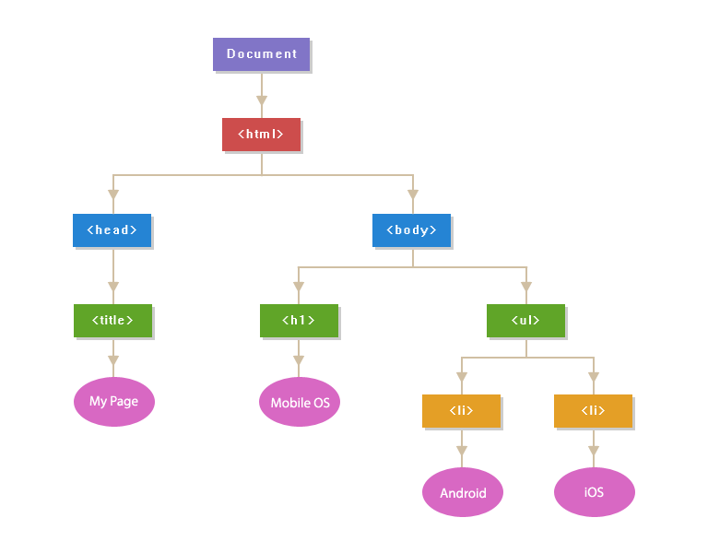
Introduction to jQuery
jQuery Attributes
Most of these attributes are available through JavaScript as DOM node properties. Some of the more common properties are −
className
tagName
id
href
title
rel
src
Image Source:https://i.stack.imgur.com/ocR0a.png
Notes:
Continuing from the last slide:
Title - Subtopic
Subtitle - Subtopic of Subtopic
Body - Description

Slide 15
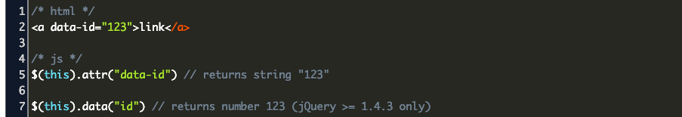
jQuery Attributes
Get Attribute Value
The attr() method can be used to either fetch the value of an attribute from the first element in the matched set or set attribute values onto all matched elements.
Image Source:https://www.codegrepper.com/codeimages/jquery-get-data-attribute-value.png
Notes:
Continuing from the last slide:
Title - Subtopic
Subtitle - Subtopic of Subtopic
Body - Description

Slide 16
jQuery Attributes
Set Attribute Value
The attr(name, value) method can be used to set the named attribute onto all elements in the wrapped set using the passed value.
Image Source: https://media.geeksforgeeks.org/wp-content/uploads/20191218175639/propActiveBold.gif
Notes:
Continuing from the last slide:
Title - Subtopic
Subtitle - Subtopic of Subtopic
Body - Description

Slide 17
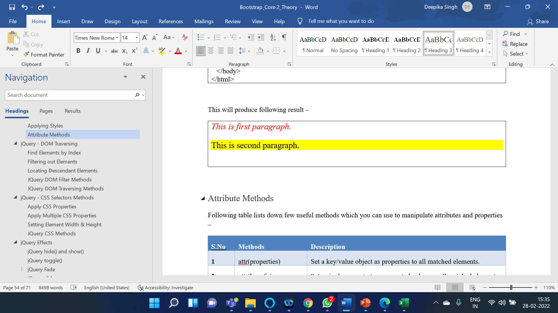
jQuery Attributes
Applying Styles
The addClass( classes ) method can be used to apply defined style sheets onto all the matched elements.
You can specify multiple classes separated by space.
Notes:
Continuing from the last slide:
Title - Subtopic
Subtitle - Subtopic of Subtopic
Body - Description

Slide 18

Introduction to jQuery
jQuery- DOM Traversing
jQuery is a very powerful tool which provides a variety of DOM traversal methods to help us select elements in a document randomly as well as in sequential method.
Most of the DOM Traversal Methods do not modify the jQuery object and they are used to filter out elements from a document based on given conditions.
Image Source:https://i.pinimg.com/originals/3d/bc/74/3dbc744d2b864e6d8780aad1ec9f4d58.jpg
Notes:
Continuing from the last slide:
Title - Subtopic
Subtitle - Subtopic of Subtopic
Body - Description

Slide 19
Introduction to jQuery
jQuery- DOM Traversing
Most of the DOM Traversal Methods do not modify the jQuery object and they are used to filter out elements from a document based on given conditions.
Find elements by index
Filtering out element
Locating descendent element
jQuery DOM filter method
jQuery DOM traversing mentod
Image Source:https://i.pinimg.com/originals/3d/bc/74/3dbc744d2b864e6d8780aad1ec9f4d58.jpg
Notes:
Continuing from the last slide:
Title - Subtopic
Subtitle - Subtopic of Subtopic
Body - Description

Slide 20
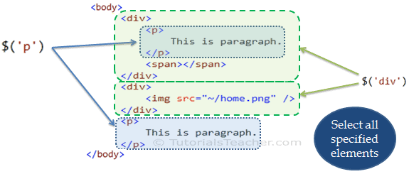
Introduction to jQuery
jQuery- CSS Selector
The jQuery library supports nearly all of the selectors included in Cascading Style Sheet (CSS) specifications 1 through 3, as outlined on the World Wide Web Consortium's site.
Image Source: https://www.tutorialsteacher.com/Content/images/jquery/jq-element-selector.png
Notes:
Continuing from the last slide:
Title - Subtopic
Subtitle - Subtopic of Subtopic
Body - Description

Slide 21
Introduction to jQuery
jQuery- CSS Selector
Most of the JQuery CSS Methods do not modify the content of the jQuery object and they are used to apply CSS properties on DOM elements.
Apply CSS Properties
Apply multiple CSS Properties
Setting Element width & height
jQuery CSS method
Image Source: https://www.tutorialsteacher.com/Content/images/jquery/jq-element-selector.png
Notes:
Continuing from the last slide:
Title - Subtopic
Subtitle - Subtopic of Subtopic
Body - Description

Slide 22
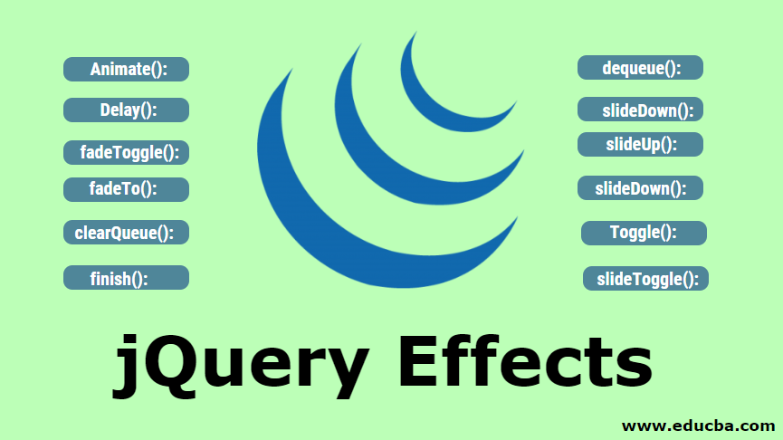
Introduction to jQuery
jQuery- Effect
jQuery provides a trivially simple interface for doing various kind of amazing effects.
jQuery methods allow us to quickly apply commonly used effects with a minimum configuration.
Image Source: https://cdn.educba.com/academy/wp-content/uploads/2019/09/jquery-effects.png
Notes:
Continuing from the last slide:
Title - Subtopic
Subtitle - Subtopic of Subtopic
Body - Description

Slide 23
Introduction to jQuery
jQuery- Effect
This content covers all the important jQuery methods to create visual effects.
jQuery hide() and show()
jQuery toggle
jQuery fade
jQuery slide
Image Source: https://cdn.educba.com/academy/wp-content/uploads/2019/09/jquery-effects.png
Notes:
Continuing from the last slide:
Title - Subtopic
Subtitle - Subtopic of Subtopic
Body - Description

Slide 24
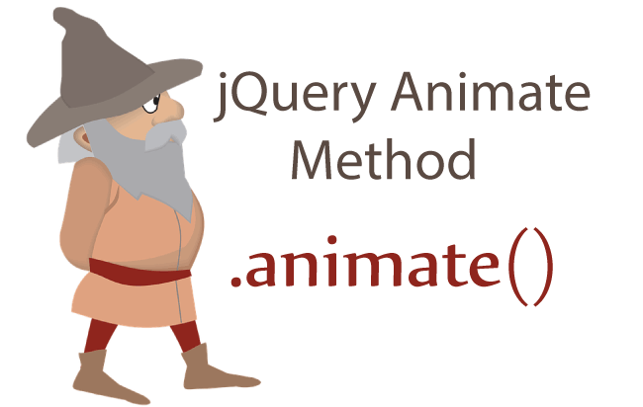
Introduction to jQuery
jQuery- Animation
The jQuery animate() method performs custom animation using element's style properties.
The animate() method changes existing style properties to the specified properties with motion.
Image Source: https://www.yogihosting.com/wp-content/uploads/2017/11/jquery-animate.png
Notes:
Continuing from the last slide:
Title - Subtopic
Subtitle - Subtopic of Subtopic
Body - Description

